Slide 1
Adversarial Graph Augmentation to Improve Graph Contrastive Learning
NeurIPS 2021
Code: github.com/susheels/adgcl
2022.01.05 • ChongQing
Reported by Chenghong Li

Slide 2
Introduction
Adversarial Graph Augmentation
Graph Contrastive Learning

Slide 3
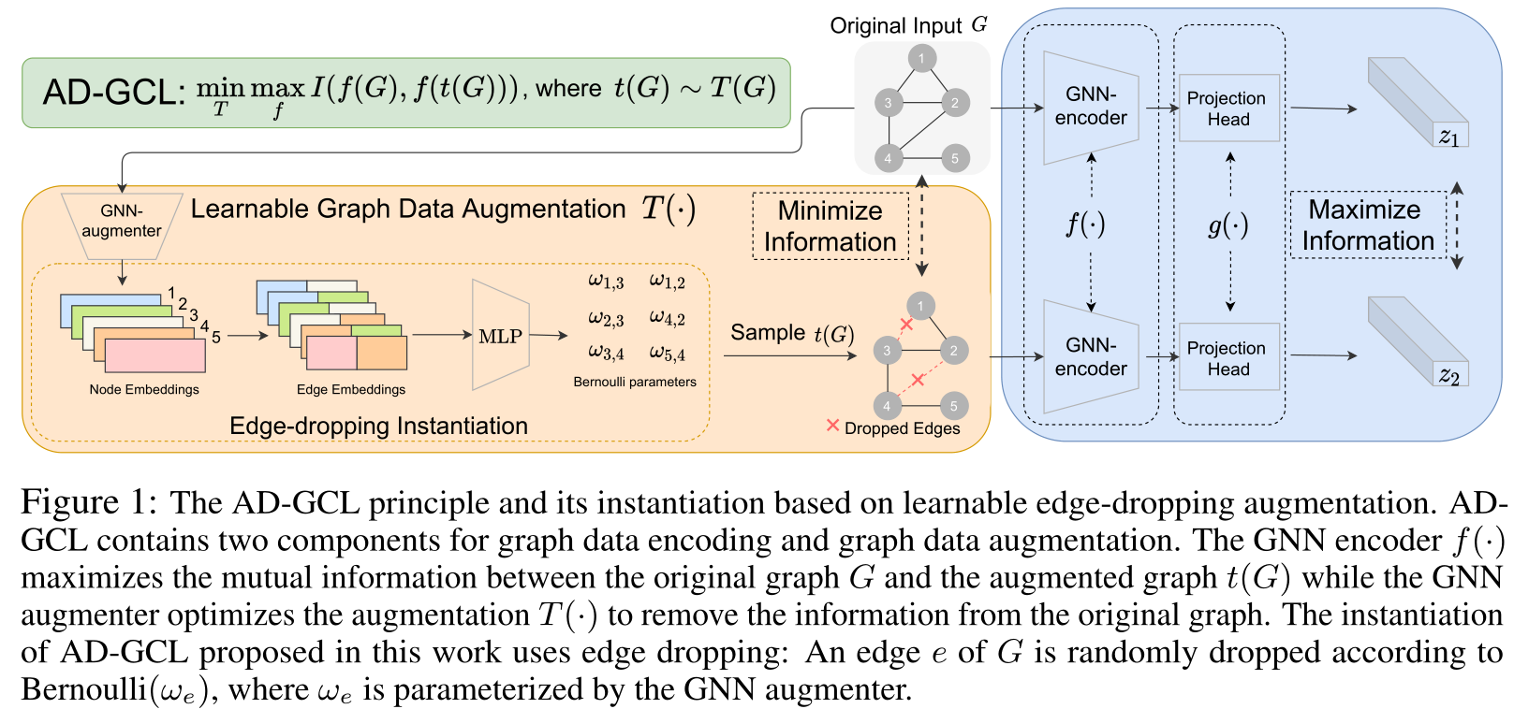
Method

Slide 4
Method

Slide 5
Method

Slide 6
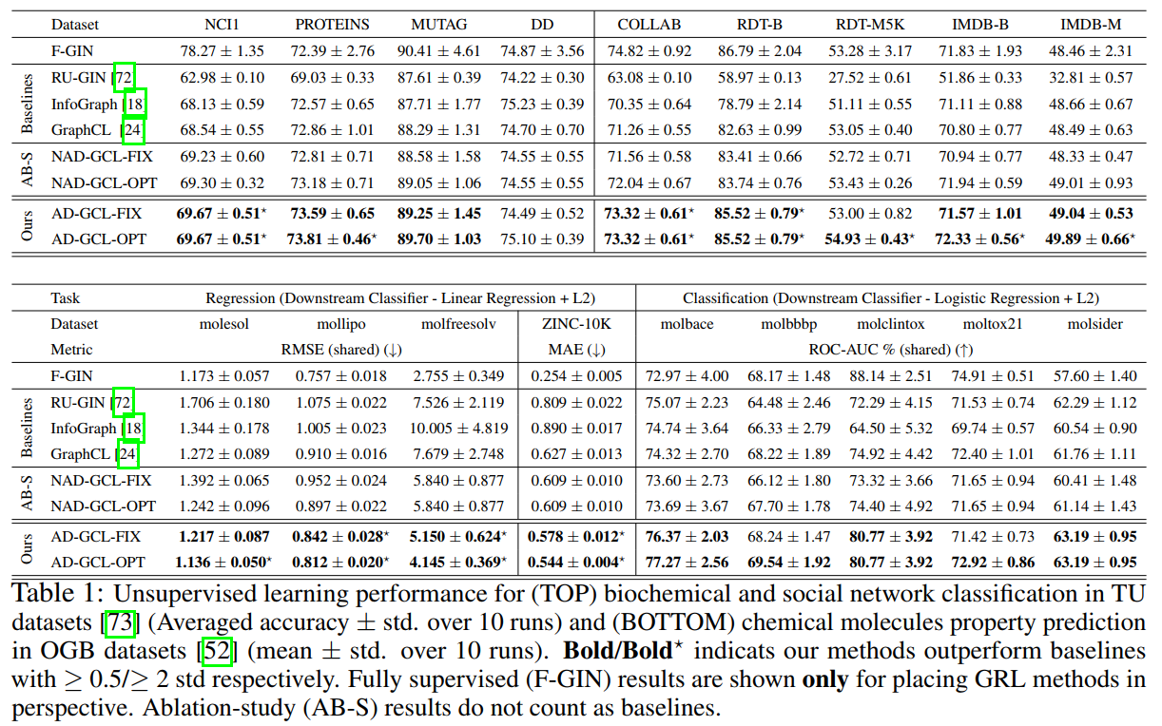
Experiments

Slide 7
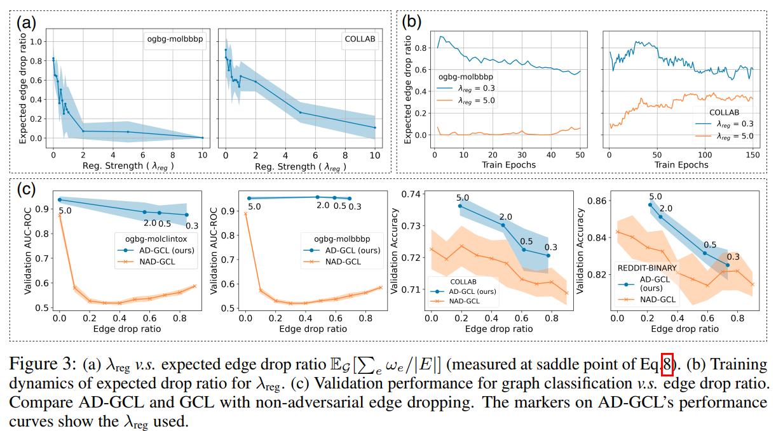
Experiments

Slide 8
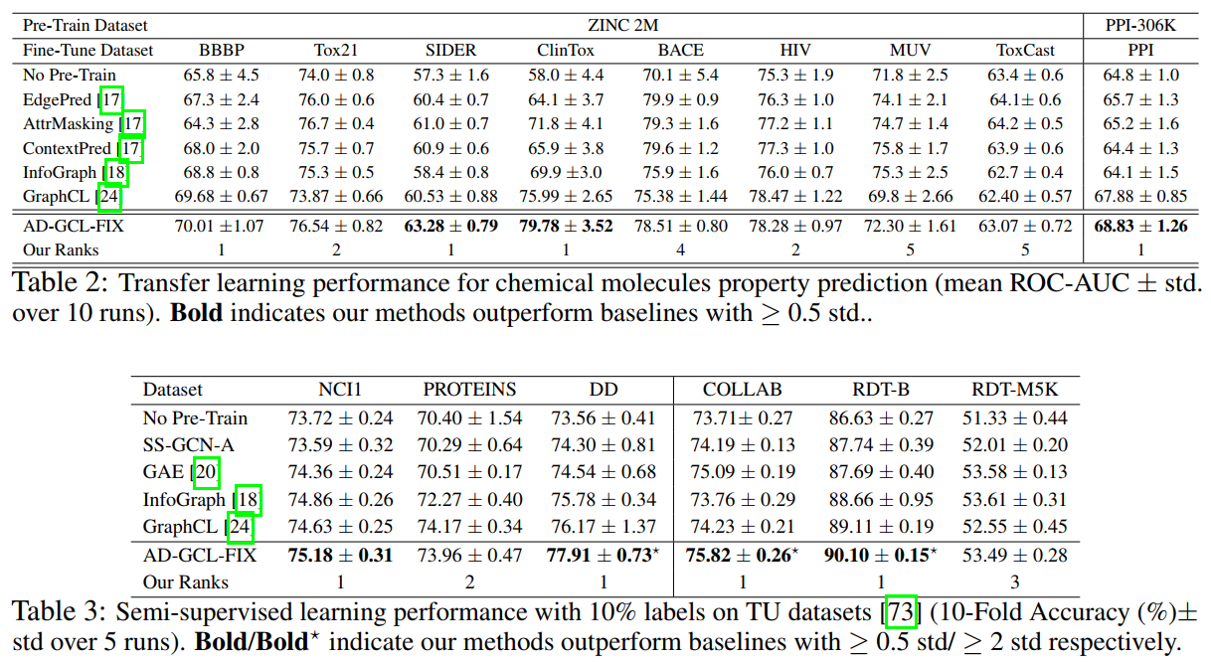
Experiments

Slide 9
Thanks

